Slide 1
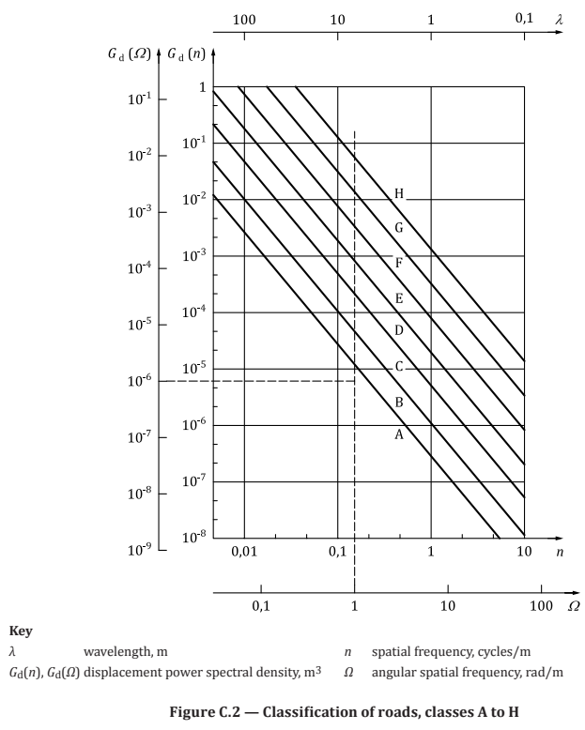
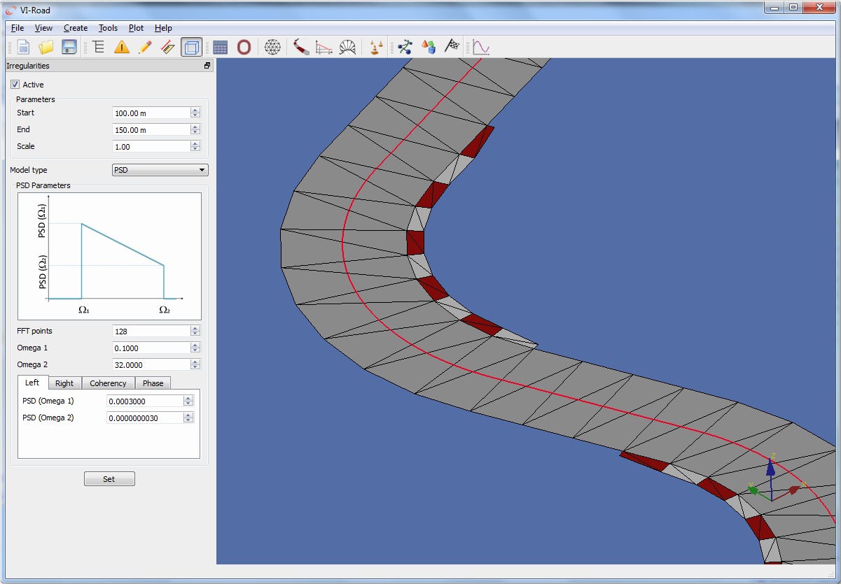
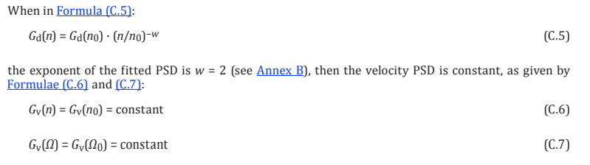
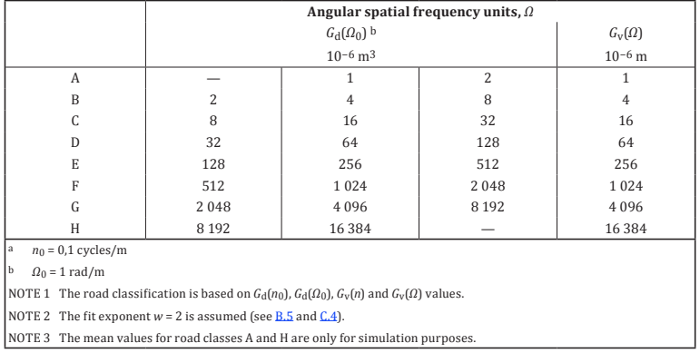
ISO Norm
The current reference ISO standard is the 8608:2016
The VI-Grade implementation, although it is not clearly specified, seem to comply with it looking to the support manual. (displacement description)
The free parameters are basically the PSD of the road profile at a lower and higher frequency references, and the coherency between left and right side.
These parameters can be calculated from the norm classification according to the following formula and tables.
The exponent w=2 is a typical suggestion in the norm, especially for paved roads.

Slide 2
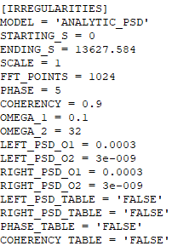
VI-Grade parameters
The roughness parameters can be specified via GUI in VI-Road or by editing the .rdf road file.
From the ISO norm and taking the same 0.1 rad/m and 32 rad/m as reference we get the following options:
Class Gd(Omega0) PSD_Omega1 PSD_Omega2
A 1 1e-4 1e-9
B 4 4e-4 4e-9
C …
So basically having opportunistically chosen omega1 and 2, we get that
PSD_Omega1 = Gd(Omega0) * 1e-4
PSD_Omega2 = Gd(Omega0) * 1e-9
Only for w=2 ! (which is true mostly for highways)
Unknown parameters:
Coherency
Phase
FFT Points

Slide 3
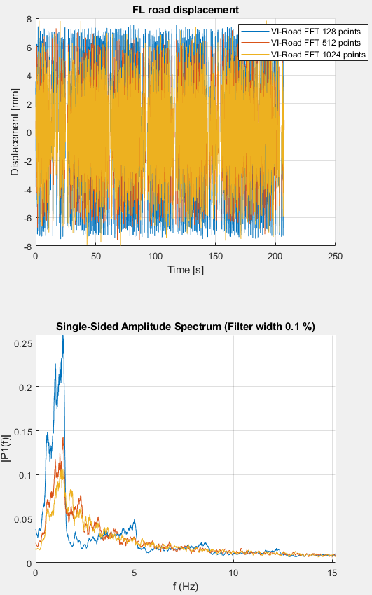
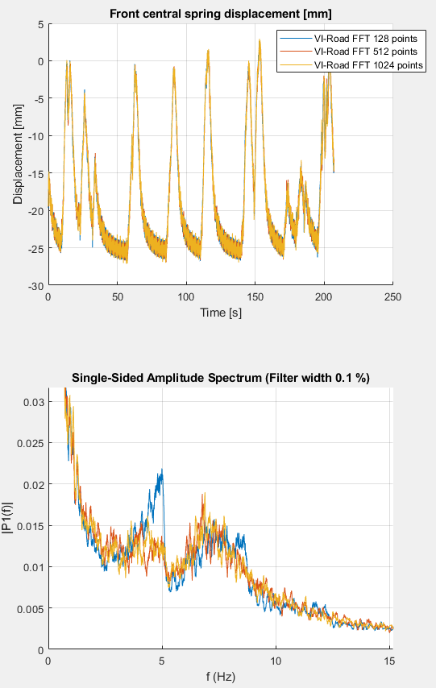
FFT Points sensitivity
Trying to identify what is a suitable number for FFT points.
Default VI-Road value 128
Example .rdf file description 512
Tested: 128,512,1024
The higher the number of FFT points -> the “smoother” the road roughness is distributed on the frequency range.
There seem no good reason to reduce the number of points, as the calculation performance is affected in a negligible way in this range.
The current idea is to use 1024 or higher.
There are more details in the norm document, to be evaluated.

Slide 4
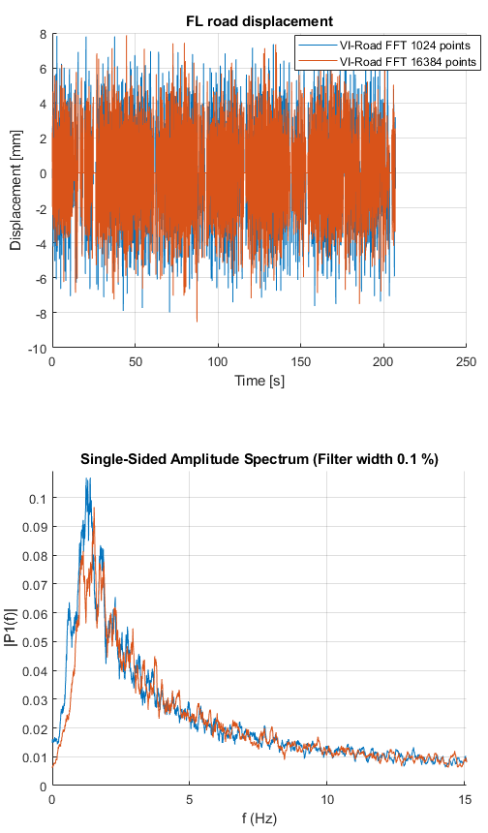
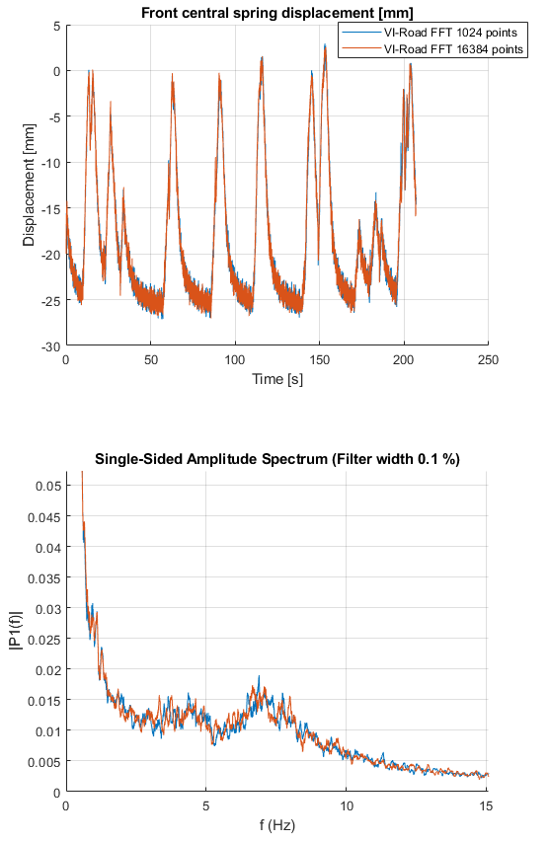
FFT Points sensitivity
Increasing from 1024 to 16384 points:
Much lower execution speed (>10 times)
Similar results
2048 points should be a good compromise.

Slide 5
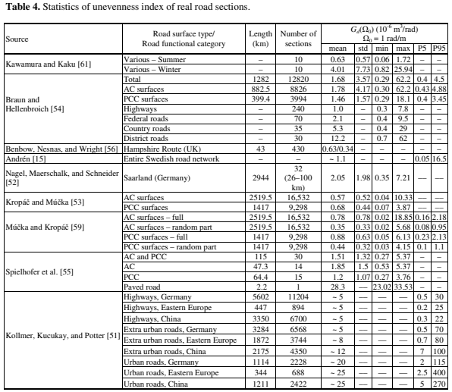
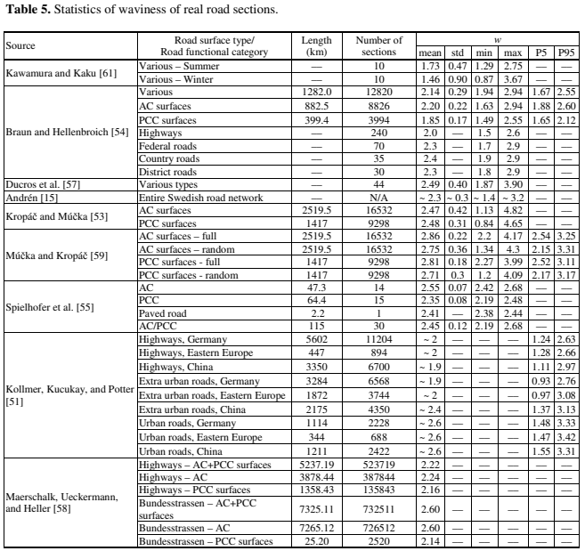
Track assignments
If we look to the data from different publications
(resumed in “Simulated Road Profiles According to ISO 8608 in Vibration Analysis” by Mucka 2018)
Gd(Omega0) w
Le Mans “Extra urban roads, Germany” 5e-6 m³/rad 2
Sebring “Urban roads, Eastern Europe” 25e-6 m³/rad 2.6

